Slide 1
Attendance Through Hotspot
Kamal S 715521104020
Thulseram Naidu 715521104311
Ashokkumar S 715521104302
Isaac Abraham Thottahil 715521104018

Slide 2
Aim of The Project
To allow teachers to take attendance quickly with help of Android Mobile Application.
Uses Hotspot of the Teachers phone and finds all students connected to the hotspot and automatically marks attendance.
To make attendance faster and much secure.
Allows Teachers to have fast analysis convert attendance to CSV.

Slide 3
Tech Stack Used
Kotlin (For Android Application)
Ktor Server and Ktor Client
Firebase Firestore (Stores Teachers Data and Students’ Data)
Sqlite in Teacher’s Phone (Local DB to store Attendance)
Firebase Email Authentication

Slide 4
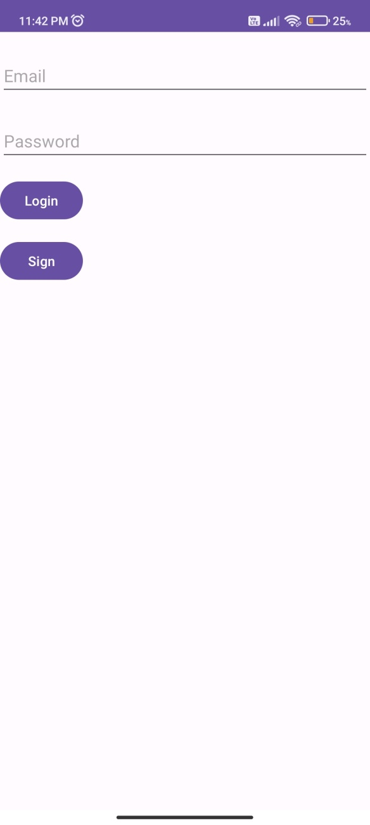
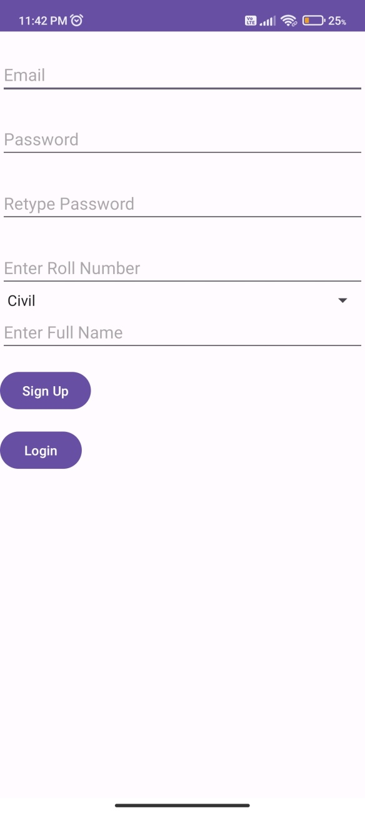
Login and SignUp –Common To Both Apps

Slide 5
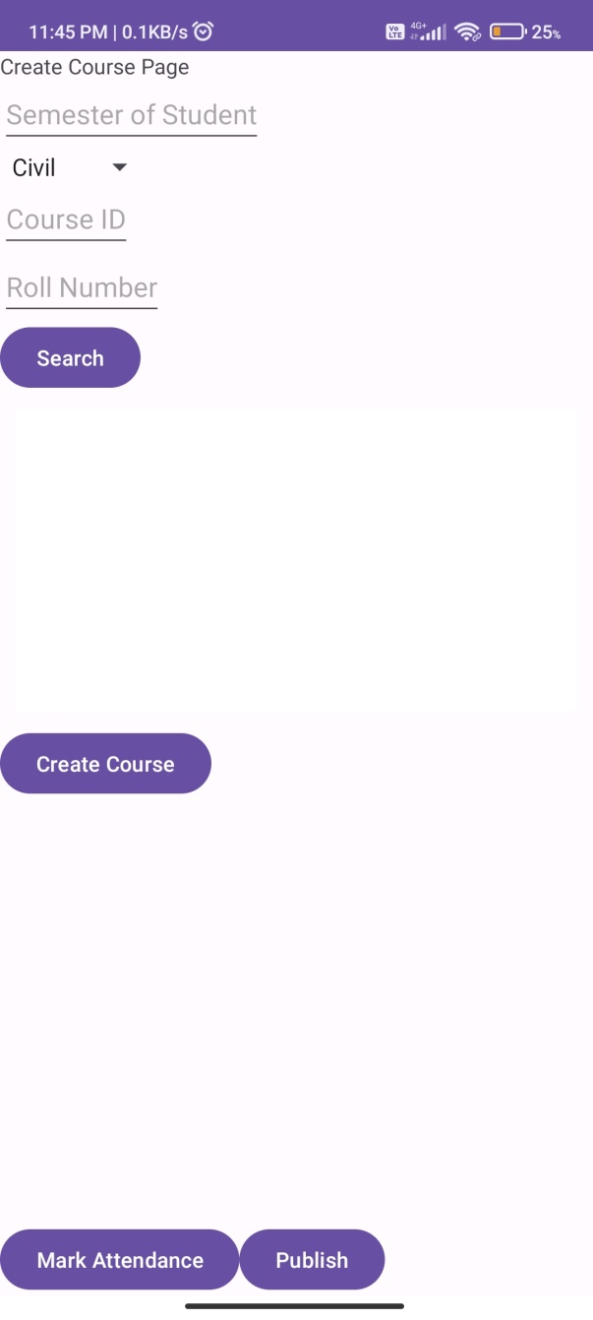
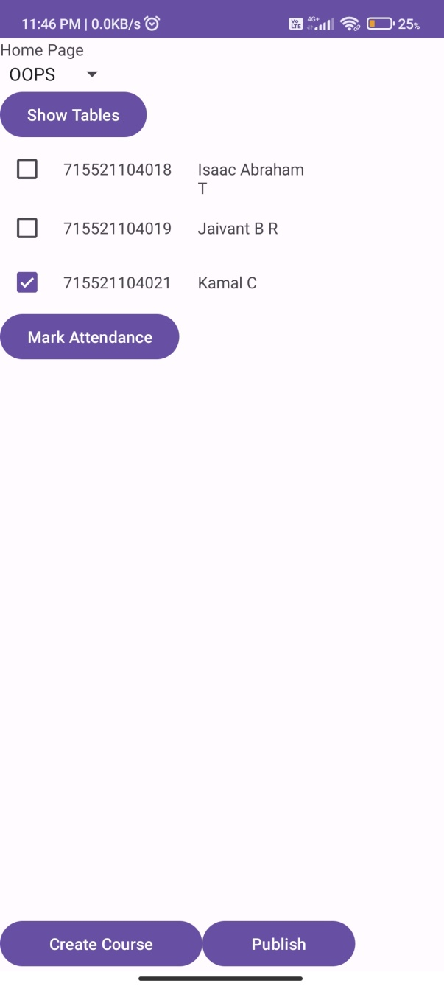
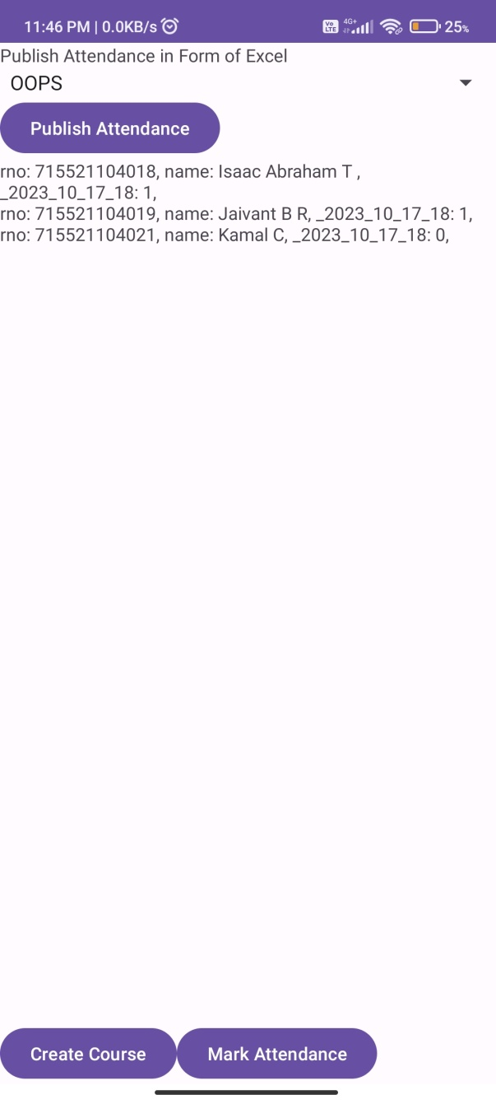
Teachers App

Slide 6
Teachers APP
Create Course Page :
Finds Roll Number from Firestore DB
Stores course in sqlite Local DB(table name course, column name rno)
Home Page:
Shows list of created courses from Local DB in drop box
On clicking Show Tables Start server and accepts attendance for the course for the current hour. Manual and automatic allowed
Mark Attendance button creates new column with current date and hour
Publish Attendance Page
Takes the current table and converts to csv and sends to other people

Slide 7
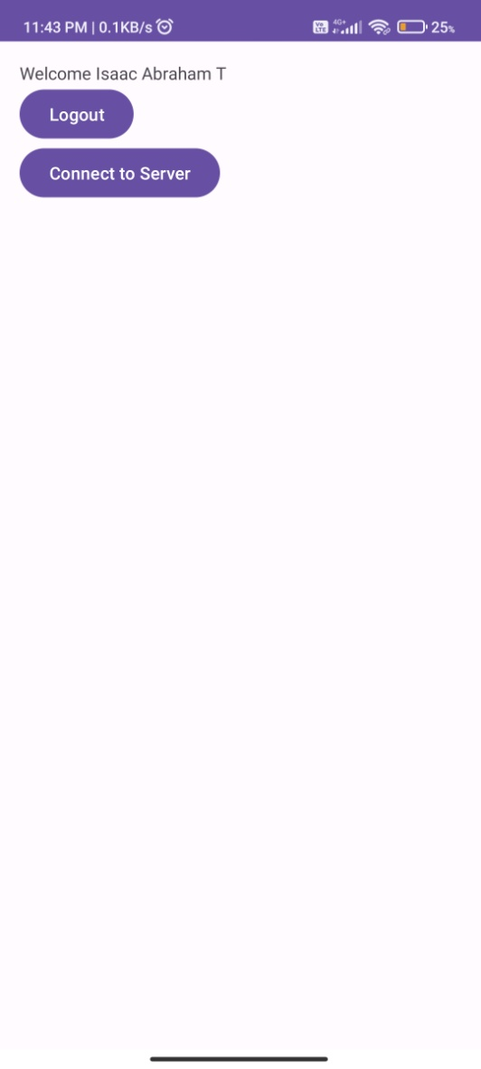
Student App

Slide 8
Future Improvement
Allow Students to login with only Phone number by recognizing SIM details, restricts 1 phone to 1 account.
Give Teachers More Comprehensive View of current students present, which students are frequently absent and generate specific reports
Give Students App better UI update and store on Students App their frequent attendance, and helps students to track their attendance.

